Slide 1



Department of Computer Science and Engineering
Project Progress Seminar
Session: 2023-2024
Group Number: - CSE_B_04
Date : 26-10-2023
Title of the Project:- Missing people identification using Deep learning
Presented By:
Lalit Kondekar (B 18)
Lokesh Burade (B 19)
3. Nrupraj Bhendarkar (B 29)
4. Ruchi Maurya (B 12)
Guide
Prof. Imran Ahmed
Assistant Professor
GHRCE, Nagpur

Slide 2


Missing people identification using Deep learning
Use of face recognition for finding the missing people

Slide 3

Abstract
In India a countless number of people are reported missing every year. Among the missing people cases a large percentage of people remain untraced. This paper presents a novel use of deep learning methodology for identifying the reported missing people from the photos of multitude of children available, with the help of face recognition. The public can upload photographs of suspicious people into a common portal with landmarks and remarks. The photo will be automatically compared with the registered photos of the missing child from the repository. Classification of the input child image is performed and photo with best match will be selected from the database of missing people. For this, a deep learning model is trained to correctly identify the missing people from the missing people image database provided, using the facial image uploaded by the public. The Convolutional Neural Network (CNN), a highly effective deep learning technique for image based applications is adopted here for face recognition.

Slide 4

Introduction
In our society, a countless number of people are missing every day which includes kids, Teens, Girls, Mentally challenged, Old-aged people with Alzheimer's, etc. As the number of missing complaints in the present society are getting increased the responsibility of searching them on police becoming quite challenging. Even though missing cases are getting filed against them in police stations. It is complicated to trace them through investigation as it requires lot of efforts and time. Even though cc footages are available sometimes, it takes lot of effort to go through each and every recorded video present in the database. It is time taking and hectic work. This made us to plan something named “missing person identification using face recognition”, which makes our task quiet simpler. The main intention of the this project "Missing person identification" is to locate the missing person using mobile through their face recognition and to give alert to the police station along with the location in the form of SMS. It also allows normal people to upload the pictures of any suspicious persons who they come across. If the complaint is already filed against the same person in the portal it will show an alert to the police.

Slide 5
Project Description
Objective:
To develop a face recognition system using Deep learning.
Integration of face recognition system with the WCD missing people database.
Providing a easy and minimal interface for the user to search for the missing person.

Slide 6
Project Description
Scope :
Development and evaluation of a face recognition system for identifying missing individuals using deep learning techniques.
Creation of a functional prototype that can match uploaded images against a database of known missing persons, facilitating the potential identification of individuals who may have been reported as missing.

Slide 7
Project Description
Benefits:
Enhanced accuracy: Deep learning models can achieve high accuracy in identifying missing persons, even in challenging conditions such as low light or poor image quality.
Improved efficiency: Deep learning-based face recognition systems can quickly and efficiently search through large databases of images, helping law enforcement agencies to generate leads and identify suspects faster.
Increased scalability: Deep learning systems can be scaled to handle large and growing datasets of images, making them suitable for real-world applications such as nationwide missing person searches.
Reduced costs: Deep learning-based face recognition systems are becoming increasingly affordable, making them accessible to law enforcement agencies of all sizes.

Slide 8
Hardware /Software Specification
Hardware Requirements
Processor 2.0 Ghz processor speed
Memory 2GB RAM
32 Bit CPU
Software Specifications
Operating System- windows 7 , android 9.
Web Browser (Firefox, Chrome, Edge, Brave)

Slide 9

Literature Survey
Sr. No | Title of the paper | Year of publication | Algorithm/ technique/ tools used | Accuracy/ Result Achieved | Remarks
1 | MISSING PERSON IDENTIFICATION SYSTEM | 2023 | Convolutional Neural Network (CNN), Long Short-Term Memory (LSTM) | 95% | The proposed system uses CNN and LSTM to identify missing persons. The CNN is used to extract features from the missing persons' faces, and the LSTM is used to track the changes in the features over time.
2 | Finding Missing Person/Child Using AI | 2023 | Facial recognition, deep learning, natural language processing, geolocation analysis, data fusion, and multimodal analysis | 95% | The proposed model is able to identify missing children with high accuracy by using a variety of AI techniques.

Slide 10
Literature Survey
3 | Missing Person Identification System | 2023 | Convolutional Neural Network (CNN) | 90% | The proposed system uses CNN to identify missing persons. The system is able to learn the features of the missing persons' faces and match them with the faces in the database.
4 | A Review on Identification of Missing Persons and Criminals using Image Processing | 2022 | Image processing, face recognition | 91.66% | The system is able to achieve high accuracy even when the images of the missing persons are of poor quality.
5 | "MISSING PERSON IDENTIFICATION USING FACE RECOGNITION" | 2022 | Deep Learning (CNNs), Feature Extraction, Matching Algorithms | Varies depending on dataset and method | Highlights the advancements in facial recognition techniques for identifying missing persons. Discusses challenges such as illumination, pose, and age variations.

Slide 11
Literature Survey
6 | MISSING PEOPLE DETECTION SYSTEM | 2022 | RFID Technology, face recognition | 91.66% | The proposed system uses RFID Technology and face recognition to identify missing persons. The RFID Technology is used to track the movement of the missing persons, and the face recognition is used to identify the missing persons' faces.
7 | “Criminals And Missing Children Identification Using Face Recognition And Web Scrapping" | 2020 | Creating web application using flask using beautifulsoup tools, harcascade algorithm classifier | 90% | This requires less memory space to implement and takes less time when compared with other approaches.

Slide 12
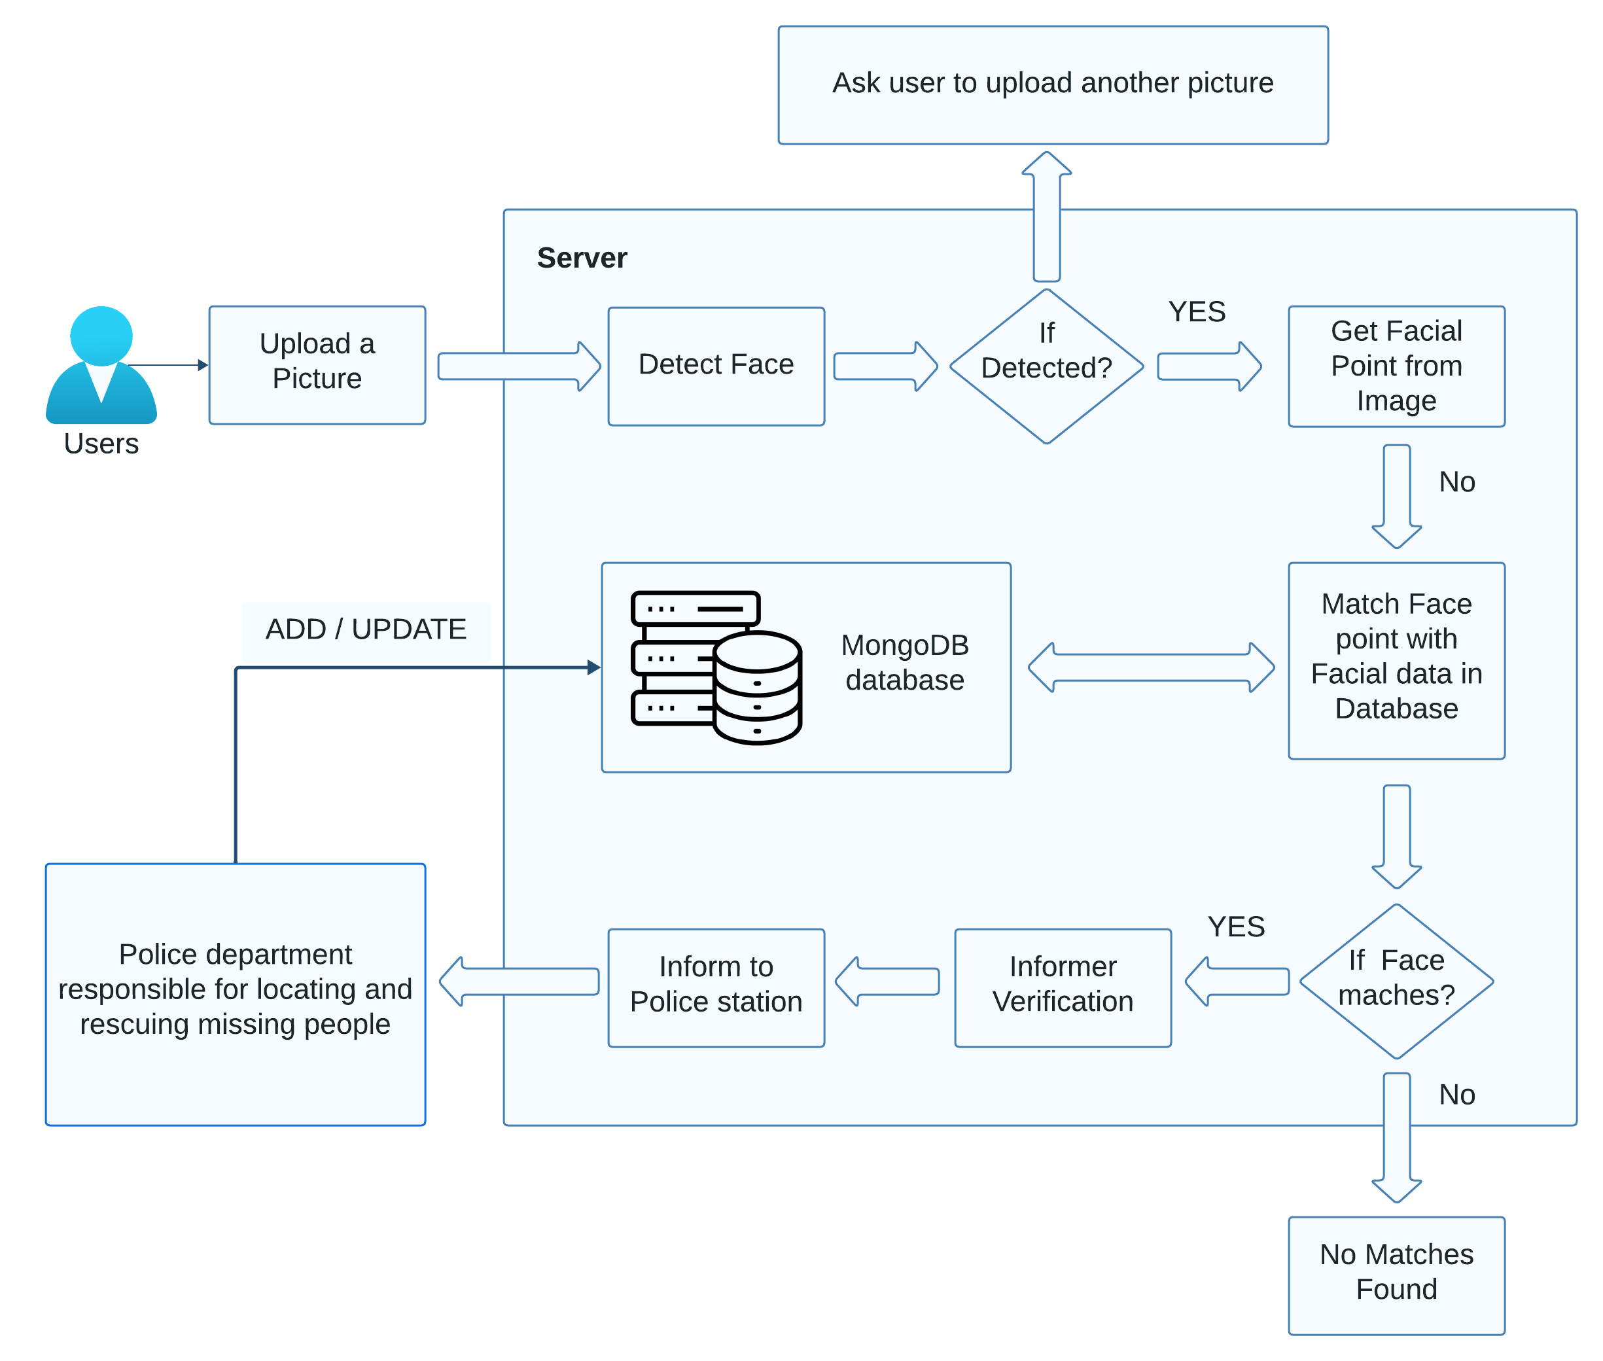
Proposed Methodology/System Architecture
The proposed system utilizes face recognition for missing people identification. This is to help authorities and parents in missing people investigation. The architecture of the proposed framework is given below
Images of reported missing people are saved in a repository and the face area is selected for cropping to obtain input face images. Learned features from a Convolutional Neural Network (CNN), a specific type of deep learning algorithm, are used for training a multi class SVM classifier. This machine learning approach is used to correctly label the child using the name indicated in the database provided by the concerned authority.

Slide 13
Module Description
Admin module: This module will manage all the user and API data within the app. Admin can control the information in the system.
User module: This will the user. The user will have the information like name and mobile number. This will have the access to the database and can input the child’s information and photo to find if it is a missing one.
Searching module: The searching module is the engine that powers the system's search functionality. Users can use the searching module to search for missing persons in the database by name, age, last known location, or other criteria. The searching module returns a list of matching missing persons, along with their information.
Inform to police module: The inform to police module allows users to inform the police about a suspected missing person. When a user clicks the "Inform to police" button, the system sends a notification to the nearest police station with the user's location and the image of the suspected missing person.

Slide 14
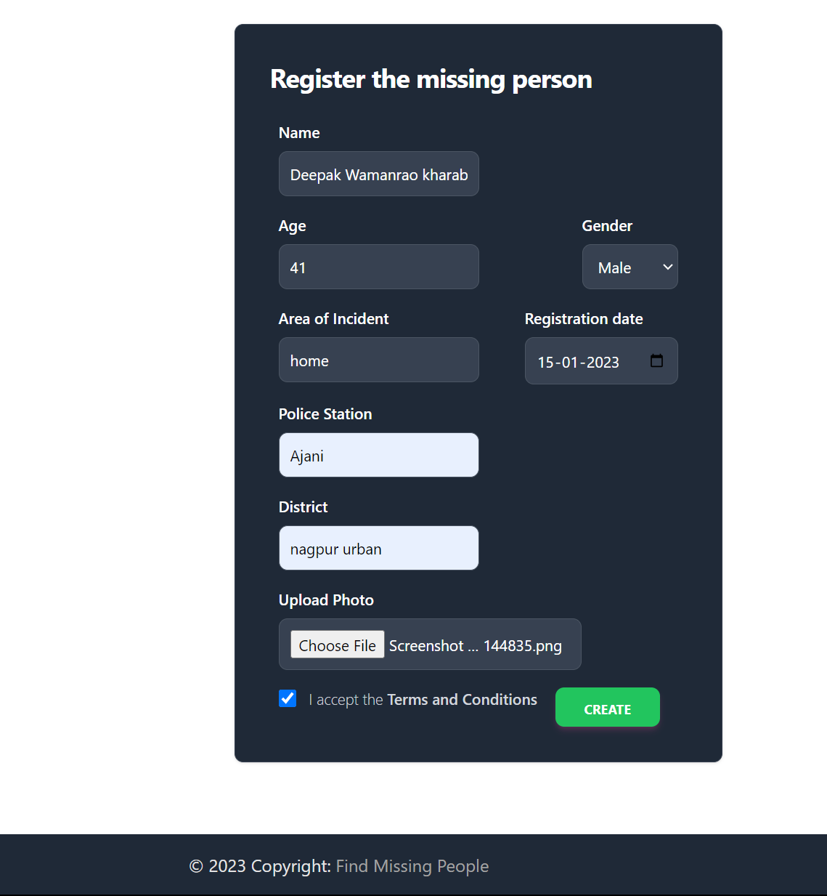
Project Screenshots
The Person’s Information Page:
Graspable Input Fields
Input Fields :
Name of missing person
Age of person
Gender
Area of Incidence
Reported Registration Date
Reported Police Station
District : Region of Incident
Upload a Photo of missing person

Slide 15
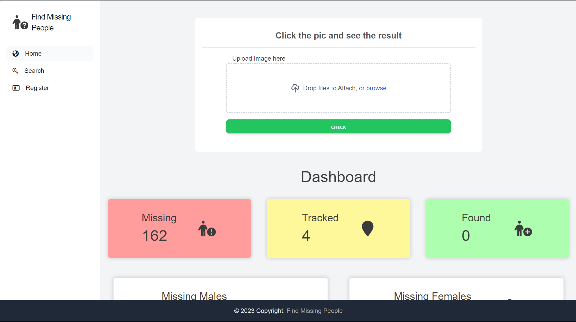
Project Screenshots
The HOME page :
Minimalistic search interface
Searching option through images:
Upload an image file.
Search
Search option through name:
Enter the name of person
Search
Search option through Area
Enter the Location (area)
Search

Slide 16


Project Screenshots
Result Page for Searched person:
Easy user interface
If Searched person’s image matches in database, the reported image of person pop-up for verification by uploader. Click on Image if yes. If image not found Database it shows not found.
Information of matched person:
Easy user interface
If Searched person’s image matches in database, here Name, Registration date and place, Police station and Region of incident shows and ask for ‘Inform to police’ button.

Slide 17

Project Screenshots
All missing people page :
User friendly layout
Navigate from Home > search > All missing people. Click on search button without filling any option input fields.
All the entries of missing people shows here with name, age and image.

Slide 18
Conclusion
A missing child identification system is proposed, which combines the powerful CNN based deep learning approach for feature extraction and support vector machine classifier for classification of different child categories. This system is evaluated with the deep learning model which is trained with feature representations of people faces

Slide 19
Reference
[1] Ashwin Late, Jatin Natekar, Zaid Khan, Sahil Thakare, “MISSING PERSON IDENTIFICATION SYSTEM”, IJCRT, April 2023 🔗
[2] Divyansh Yadav, Janhvi Tyagi, “Finding Missing Person/Child Using AI”, International Journal of Research Publication and Reviews, May 2023. 🔗
[3] Prof. S. S. Pawar, Niraj Lohani, Ayush Kumar, Ritik Sharma, Abhishek Kadam, “Missing Person Identification System”, International Journal of Advanced Research in Science, Communication and Technology, May 2022. 🔗
[4] Ms. Neha Ahirrao, Ms. Shreya Jade, “A Review on Identification of Missing Persons and Criminals using Image Processing”, IJCRT, July 2022 🔗
[5] Dariusz PIERZCHALA, Tomasz GUTOWSKI , “Machine Learning-Based Method for Recommendation of Missing Person's "Search Level”, January 2021 🔗
[6] Muhammad Ashraf , Nauman Qadeer, Amir Mehmood , “Tracking Missing Person in Large Crowd Gathering Using Intelligent Video Surveillance”, journal paper, 2022 🔗
[7] Dr. S. MATILDA, “Criminals And Missing Children Identification Using Face Recognition And Web Scrapping”, IEEE explore, December 2020. 🔗

Slide 20

Thank You!

